Slide 1
Fixed parameter algorithms
Introduction
Slides based on original material by:
Rolf niedermeier and mike fellows

Slide 2
Map of the next 45 minutes
By the end of today you will be able to:
Define what is an FPT algorithm
Explain how to get a k² kernel for vertex cover
Explain how to get a k² kernel for max-satisfiability
Understand what is kernelization and what is its connection with FPT

Slide 3
The “classical” P vs NP framework is one-dimensional
n = input size
poly(n)
2 ^{poly(n)}
vs
“good”
P
positive toolkit of how to design P-time algorithms
“bad”
NP, etc.
negative toolkit of NP-hardness, etc.
Unfortunately, almost everything turns out to be NP-hard.

Slide 4
The parameterized framework is two-dimensional
n = input size
k = a relevant secondary measure
f(k)n^{c}
vs
n ^{g(k)}
“good”
FPT
“bad”
Not discussed in this lecture

Slide 5
Framework in pictures
The classical P vs NP framework
Intrinsic Combinatorial explosion: Most problems are NP-hard or worse.
n
The parameterized framework
k
FPT
n^{c}
Try to confine the explosion to the parameter.

Slide 6
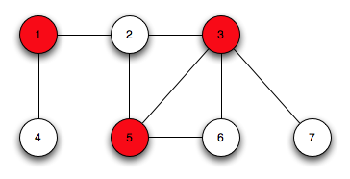
Vertex cover
An NP-complete problem
Easily parameterized (by the size of the set)
Vertex-cover(G,k)
Input: An undirected graph G = (V, E) and a nonnegative integer k.
Task: Find a subset of vertices C ⊆ V with k or fewer vertices such that each edge in E has at least one of its endpoints in C.
Any other parameters?
Notes:
Other possible parameters: The maximum degree, number of connected components, The amount of edges you need to remove before the instance is a tree

Slide 7
Vertex cover: Observations
First, all vertices without edges connected are discarded.

Slide 8
Vertex cover: Observation 1
If v has degree at least k+1, then v belongs to each vertex cover in G of size at most k.
If v is not in the vertex cover, then all its neighbors are in the vertex cover.

Slide 9
Vertex cover: Observation 2
(After applying observation 1) We are left with vertices with degree at most k
Every edge needs to be covered, but every vertex has at most k neighbors.
Thus, if we have more than k² edges, no Vertex cover is possible

Slide 10
We are left with
At most k² edges and at most 2k² vertices are left (otherwise we can safely reject the instance)
Iterating on the vertices in the kernel we can achieve a running time of :
Exponential explosion ? Yes, but only w.r.t k and not n.

Slide 11
Definitions
A parameterized problem is a language
L ⊆ Σ∗ × Σ∗, where Σ is a finite alphabet. The second component is called the parameter of the problem.
A parameterized problem is fixed-parameter tractable if it can be determined in f (k) · |x|^{O(1)} time whether (x, k) ∈ L, where f is a computable function only depending on k. The corresponding complexity class is called FPT.

Slide 12
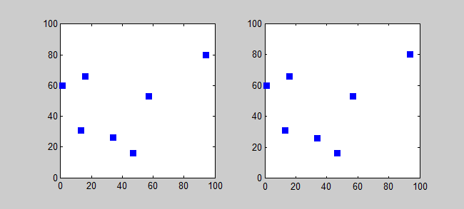
TSP is also FPT …
for k = number of cities by “try all permutations” implies a - k! n algorithm
A parameterized problem can be ”trivially FPT”
It is still interesting to look for ”better FPT” such as 2^{k}n
Notes:
The following slide demonstrates the idea that every problem in NP-complete can be parameterized by a naïve and totally disfunctional parameter.

Slide 13
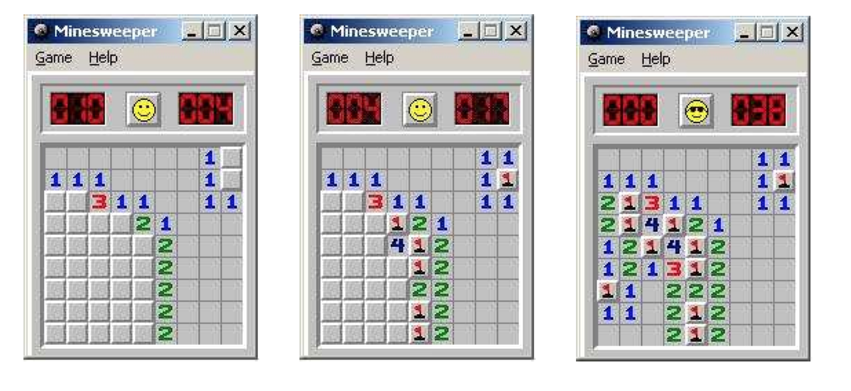
Kernelization
Preprocessing rules reduce starting instance to one of size f(k)
Should work in polynomial time
Then use any algorithm to solve problem on kernel
Time will be:
p(n) + g(f(k))

Slide 14
Formal definition of kernelization
Let L be a parameterized problem, that is, L consists of (I, k), where I is the problem instance and k is the parameter. Reduction to a problem kernel then means to replace instance (I, k) by a “reduced” instance (I’, k’) (called problem kernel ) such that:
1. k’ ≤ k, |I’| ≤ g(k) for some function g only depending on k
2. (I,k) ∈ L iff (I’,k’) ∈ L
3. The reduction from (I, k) to (I’, k’) has to be computable in polynomial time.

Slide 15
Kernelization for Vertex Cover
H = G; ( S = ø ; )
While there is a vertex v in H of degree at least
k+1 do:
Remove v and its incident edges from H
k = k – 1; ( S = S + v ;)
If k < 0 then return false
If H has at least k²+1 edges, then return false
Remove vertices of degree 0
Solve vertex cover on (H,k) with some algorithm

Slide 16

CNF, a reminder
A formula is in conjunctive normal form (CNF) if it is a conjunction of clauses, where a clause is a disjunction of literals
Example :
(x1 ∨ x2 ∨¬x3)∧(x1 ∨x2 ∨x3)∧(¬x1 ∨x2 ∨x3)∧(x2)
The size of the instance is the number of literals in total
In this example : 10

Slide 17
MAXIMUM SATISFIABILITY
Input: A boolean formula F in conjunctive normal form consisting of m clauses and a nonnegative integer k.
Task: Find a truth assignment satisfying at least k clauses.
(x1 ∨¬ x2 ∨x3)∧(x1 ∨x2 ∨x3)∧(x1 ∨x2 ∨x3)∧(x2)
We will prove that the problem has a kernel of size k²

Slide 18
Observation 1:
If k ≤ ⌈m/2⌉, then the desired truth assignment trivially exists:
Take a random truth assignment.
If it satisfies at least k clauses then we are done.
Otherwise, flip the assignment
(x1 ∨¬ x2 ∨x3)∧(¬x1 ∨¬x2 ∨¬x3)∧(x1 ∨x2 ∨x3)∧(x1) ∧
(x1∨ ¬x2 )
Class ex.:
1. Find an assignment that satisfies at most 2 clauses
2. Show that by flipping the assignment, 3 or more clauses are satisfied
From now on we can assume that k > ⌈m/2⌉, which implies m < 2k
Notes:
assignment to its opposite value yields a new truth assignment that now satisfies at ⌈m/2⌉ clauses.

Slide 19
Flipping : example
(x1 ∨¬ x2 ∨x3)∧(¬x1 ∨¬x2 ∨¬x3)∧(x1 ∨x2 ∨x3)∧(x1) ∧
(x1∨ ¬x2 )
x1=F x2=T x3=F
1,4,5 are false 2 and 3 are true. Let’s fliip it!
X1=T x2=F x3=T
Without even looking at 2 or 3, we know that 1,4,5 are now satisfied

Slide 20
Observation 2:
Partition the clauses of F into Fl and Fs: Fl: long clauses containing at least k literals; Fs: short clauses containing less than k literals.
(x1 ∨¬ x2 ∨x3)∧(¬x1 ∨¬x2 ∨¬x3)∧(x1 ∨x2 ∨x3)∧(x2) ∧(x1∨ ¬x2 )
Fl
Fs

Slide 21
Observation 2 (cont.)
Let L := number of long clauses (|Fl|) .
If L ≥ k, then at least k clauses can be satisfied.
for each (w.c) pick one literal and set it to satisfy the formula
(x1 ∨¬ x2 ∨x3 ∨ … ∨ x_{k} ∨ … ∨ x_{ci})
Now we are left with the case where L < k
Fl
Fs

Slide 22
Example
(x1 ∨¬ x2 ∨x3)∧(¬x1 ∨¬x2 ∨¬x3)∧(x1 ∨x2 ∨x3)∧(x2) ∧(x1∨ ¬x2 )
The 3 members of Fl are the first 3.
We can set x1 as the first clause demands (T), x2 for the second (F) and x3 for the third (T)
We are now secure that at least k (3) clauses are satisfied

Slide 23
Observation 3:
By now we already know that the instance has L < k large clauses and the total number of clauses m is strictly smaller than 2k
(F, k) is a yes-instance if and only if (Fs, k − L) is a yes-instance.
Notes:
If L < k, then an important point is that now it is sufficient to focus attention on the new MaxSat instance (F_{s},k−L), which already gives our problem kernel due to the following observations. Note that (F, k) is a yes-instance of MaxSat iff (F_{s} , k − L) is a yes-instance of MaxSat: the same reasoning as in the preceding paragraph shows that the remaining L large clauses can always be satisfied. This is true because to satisfy k − L clauses at most k − L variables (at most one variable per satisfied clause) are needed. Thus, for the L large clauses at least k − (k − L) = L variables remain to be freely set and the claimed equivalence is shown.
It remains to show that the size of the formula F_{s} (making the reduced problem instance) is bounded from above by O(k2): we have that there are m − L ≤ m small clauses, each containing at most k literals, and we have that m < 2k as explained before. Hence the total number of literal occurrences in F_{s} is bounded from above by 2k · k = 2k2. This means a quadratic-size problem kernel for MaxSat with respect to parameter k.

Slide 24
Observation 3:
(F, k) is a yes-instance if and only if (Fs, k − L) is a yes-instance.
->if (F,K) has an assignment, there are between 0 and L large clauses satisfied but certainly no less than k-L small clauses.
Thus, if there is an assignment for (F, k) there must also be one for (Fs, k − L)

Slide 25
Observation 3:
(F, k) is a yes-instance if and only if (Fs, k − L) is a yes-instance.
<- if (Fs , k − L) is a yes-instance of MaxSat:
1. To satisfy k − L clauses at most k − L variables (at most one variable per satisfied clause) are needed to be assigned, leaving L variables unassigned.
2. we can use the trick before and satisfy all the large clauses and get (F, k) of MaxSat

Slide 26
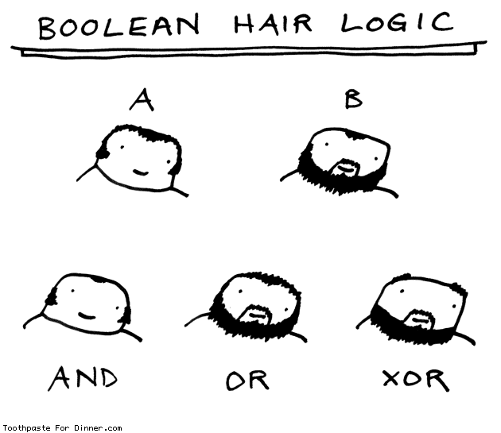
Conclusion
|Fs|= O(k²) because :
There are m − L ≤ m small clauses, each containing at most k literals
m < 2k
The total number of literal occurrences in Fs is bounded from above by 2k · k = 2k².
MAXIMUM SATISFIABILITY has a problem kernel of size O(k²)

Slide 27
The connection: Kernels and FPT
Theorem: Consider a decidable parameterized problem. Then the problem belongs to FPT, if and only if it has a kernel
<= Build the kernel and then solve the problem on the kernel
=> A little trickier …

Slide 28
FPT -> Kernel
assume that the given fixed-parameter algorithm has running time f(k) · n^{c} for some positive constant c.
Run this algorithm on the problem for at most n^{c+1} steps
two cases are possible:
The algorithm has finished its task within that time, now we have a kernelization algorithm running in polynomial time n^{c+1}, which simply outputs either a trivial “no”-instance or a trivial “yes”-instance.
The algorithm is not finished, but we can argue that n < f(k). Thus, our problem kernel is the original input instance itself.

Slide 29
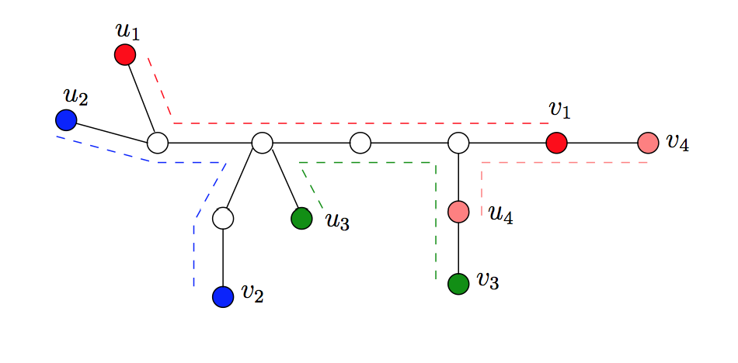
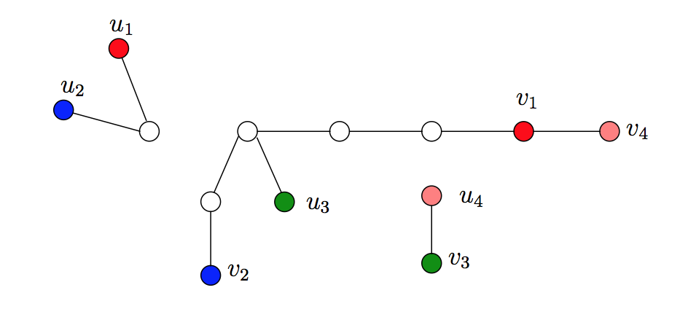
Out of the material but beautiful: Multicut in trees
Input: An undirected tree T = (V, E), n := |V |, and
H ={(u_{i},v_{i})|u_{i},v_{i} ∈V, u_{i} ≠ v_{i},1≤i≤m}.
Task: Find a minimum size set E’ ⊆ E such that the removal of the edges in E’ separates each pair of nodes in H.
Notes:
Only if we got here in before the end of the class will I show it

Slide 30
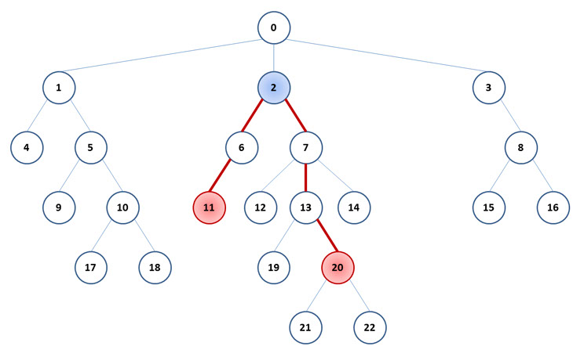
Least common ancestor in a tree

Slide 31
5 minute task
What if instead of asking which edges must we remove, we ask what vertices? How can we solve this problem?

Slide 32
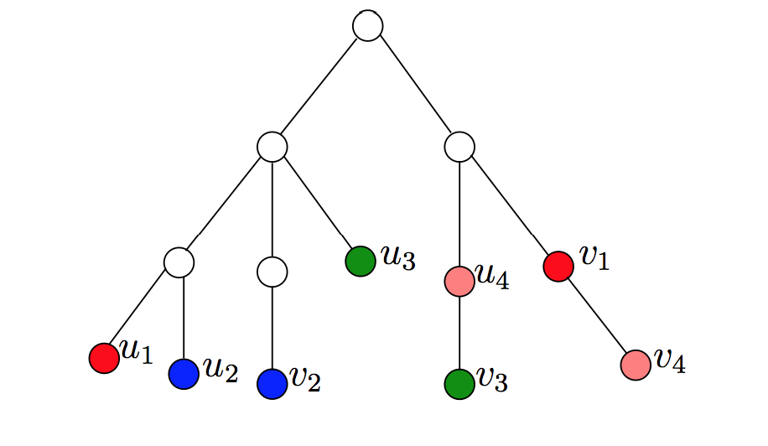
Multicut is FPT with respect to number of requests
Working bottom up, taking the NCA of each of the requests.
Search tree: 2^{k} (k := the number of edge deletions).
Recent work: the kernel is of O(k³)

Slide 33
Tips and tricks for selecting the parameter
Parameter really small
Example: Vertex Cover on planar graphs
Guaranteed parameter value
Example: Independent set on planar graphs
More than one obvious parameterization
Example :Weighted vertex cover
Close to trivial problem instances
Example :Traveling Salesperson problem in the two-dimensional Euclidean plane
Notes:
Parameter really small on vertex cover in planar graphs:planar graphs with n vertices have at most 3n − 6 edges and an average vertex degree of less than six, it is no longer clear that the vertex cover sizes for planar graphs are really “small” compared with the total number of graph vertices.
Guaranteed parameter value: for independent set on planar graphs, we need to have at least n\4 , so we can start our parameter as an additive to that
More than one obvious parameterization:

